Slide 1
Green spaces / vegetation density in Leipzig
Jakob Vogel, Erik Thiele, Tom Strempel, Richard Prußas, Maik Bachmann

Slide 2
About
goal: find and visualize relation between different social metrics and vegetation density in Leipzig
trying to answers questions like:
where are the greenest spaces in Leipzig and who lives there?
how much do vegetation density and rental prices correlate?
to do so, we are working with geospatial data as well as demographic data sets

Slide 3



2. Data
satellite data from the Sentinel 2 satellites, which observe the earth‘s surface
available through Copernicus Open Access Hub of the European Space Agency
data sets on the population of the different parts of Leipzig, made available by the city Leipzig itself on opendata.leipzig.de
more demographic data by the Genesis-online API (Statistisches Bundesamt)
https://www.esa.int/Space_in_Member_States/Germany
https://opendata.leipzig.de/dataset
https://www.destatis.de/DE/Service/OpenData/genesis-api-webservice-oberflaeche.html

Slide 4
3. Method
different metrics available to calculate vegetation density using satellite data e.g.:
NDVI (Normalized Differenced Vegetation Index)
EVI (Enhanced Vegetation Index)
both use differences in reflectance of light in near-infrared and red spectral regions due to the photosynthesis of vegetation
in short: the more near-infrared solar radiation is re-emitted, the greener the area
process / calculate that data using R, put it on a map of Leipzig
plot against different social metrics like income, rent price and possibly more

Slide 5
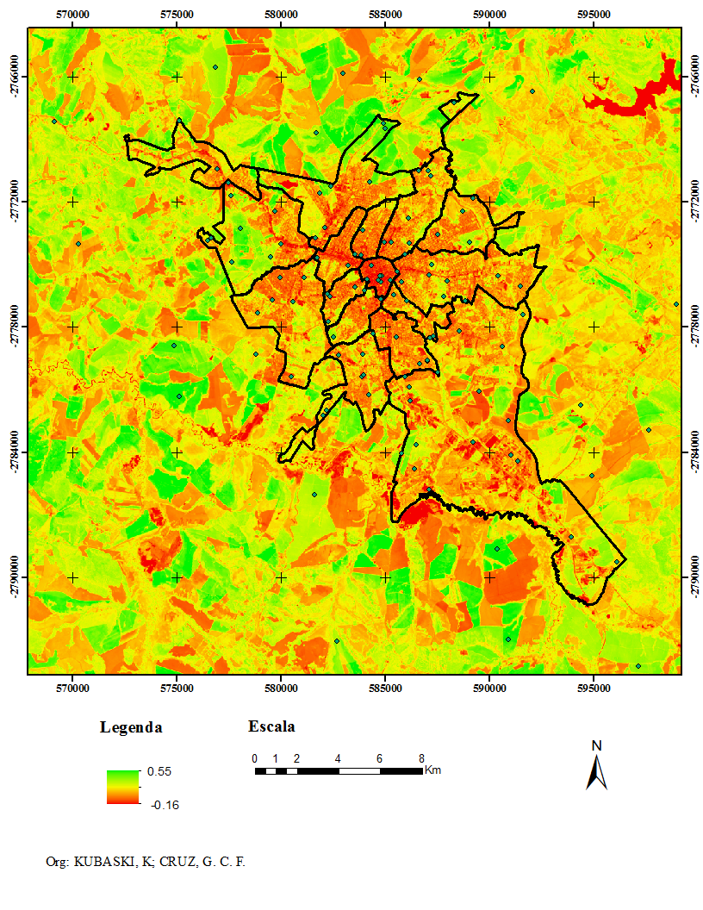
3. Method
Example for NDVI:
https://de.wikipedia.org/wiki/Normalized_Difference_Vegetation_Index#/media/Datei:NDVI_2017-09-10.png

Slide 6
4. Current state
we are in the process of obtaining data while still researching more possible data sources
next steps after exams:
starting to prepare and process data using sen2r, an R library
work on automating our current workflow
implement a function in an interactive map to visualize vegetation index for the place of residence of a user
open question: what kind of social metrics do we want to use besides income and rent?

Slide 7
5. Links
to make it easier for anyone who might be interested, here are some links to the data sources we have found so far:
https://www-genesis.destatis.de/genesis/online
https://scihub.copernicus.eu/twiki/do/view/SciHubUserGuide/
data sets provided by Leipzig (per district):
income (personal or per household): https://statistik.leipzig.de/statdist/table.aspx?cat=9&rub=1&item=316
rental cost (basic rent or total rent): https://statistik.leipzig.de/statdist/table.aspx?cat=6&rub=5
shapefiles of the districts: https://opendata.leipzig.de/dataset/geo-datensatze-zu-ortsteilen-und-stadtbezirken
miscellaneous data (if needed) per district eg. unemployment rate
https://opendata.leipzig.de/dataset?organization=amt-fuer-statistik-und-wahlen

